Slide 1
Lecture 2: GEM Versus Mature Markets: Let’s Take A Better Look At The Numbers
Booms And Busts Take Investors On A Wild Ride

Slide 2
GEM Performance—Equity Markets
Sharp upturns are followed by sharp downturns, and sideways movements, until the next upturn that may be years away.
China’s sharp upturn in 2005-7 (600% gain) was followed by a sharp downturn in 2007-9 (down close to 80%), lasting until 2014; a 2015 recovery failed to take it to 2007 highs.
Brazil’s market followed a similar pattern, gaining 1000% for the period between 1994-2008
But it has been trending lower since the last peak—rallying 64% in 2016 after falling 41 percent in 2015.
Russia was up 54% in 2016, following a 44% drop in 2015.
That’s why market timing is very important, even for long-term investors

Slide 3
Shanghai Index 2007-18

Slide 4
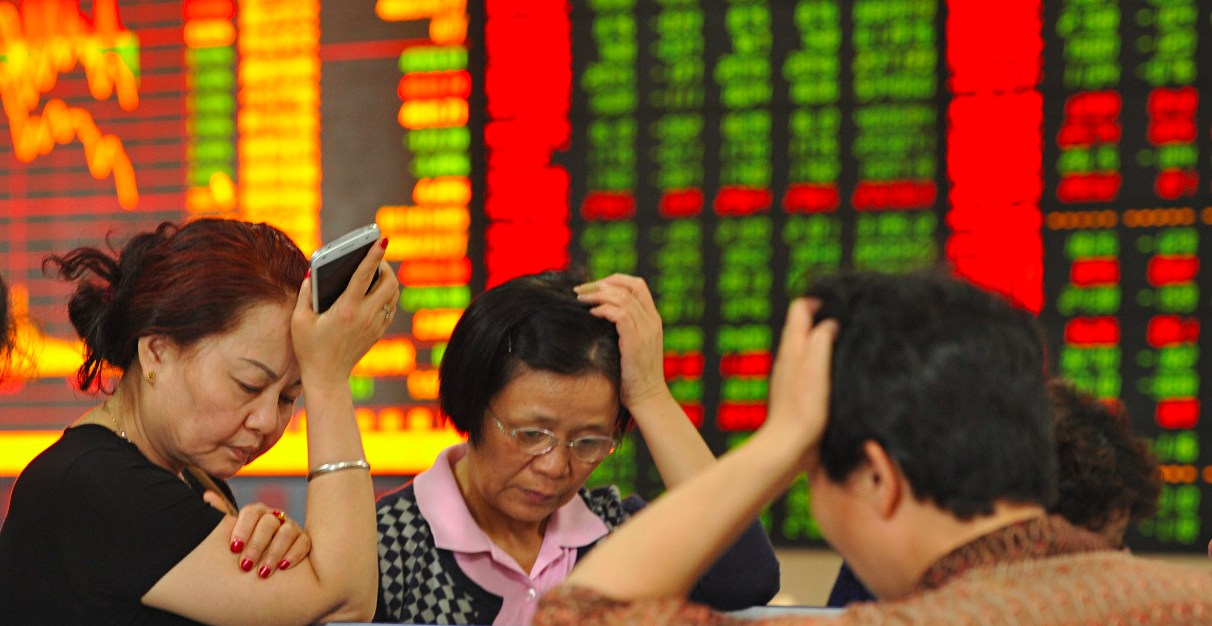
That’s A Big heading For Some Investors

Slide 5
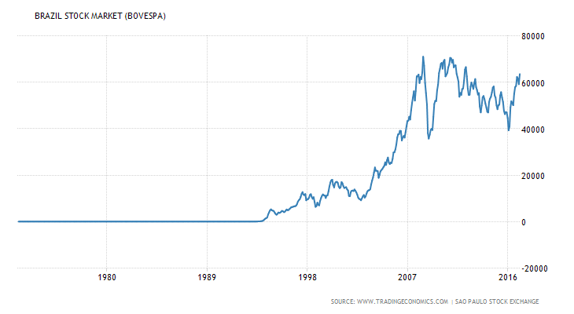
Brazil Stock Market (BOVESPA)

Slide 6
Sometimes Busts End In Crises

Slide 7
Emerging Market Busts
The 1994 Tequila Crisis
The 1997 Asian Crisis
The 1998 Russian Crisis
The 2012 Greek Crisis
The 2018 Turkish Crisis Still Unfolding

Slide 8
The 3 Elements of a “Typical” Emerging Equity Market
Deep and diverse—many stocks investors can choose from
Openness to foreign capital
Moving in tandem with major EM indexes

Slide 9
India’s “Typical” Emerging Market
Deep and Diverse—more than 5000 companies in several sectors, from autos to software and drugs
Opened to foreign capital.
Moving in tandem with MSCI Emerging Markets Index (EEM)

Slide 10
Let’s Take A Close Look
http://www.slideshare.net/sumeetbassi/indian-stock-market-presentation-220908-presentation

Slide 11
GEM Versus Mature Markets
Market Capitalization | Trading Volume | Share Concentration
Low | Low | High
High appreciation potential | High volatility (high beta) | High likelihood of market rigging

Slide 12
Market Capitalization For Selected Markets (2017)
Country | Equity Market Capitalization (%of GDP)
Vietnam | 52.2
Indonesia | 42
Philippines | 112
Korea | 109
Malaysia | 135
Japan | 128
USA | 166

Slide 13
GEM Performance: Currency Markets
High volatility—exchange risk
At the whim of monetary policies of developed countries (carry trade”).
Crashes (e.g., Asian currencies, back in 1997)
Exchange rate management—policy tool for export oriented EFM.

Slide 14
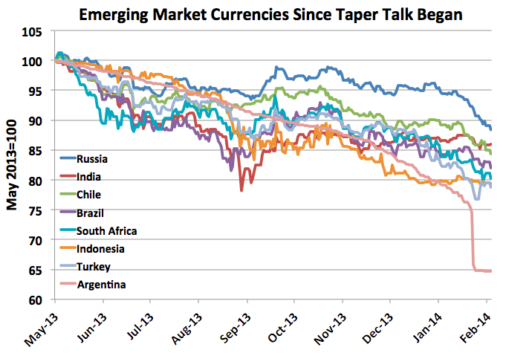
Emerging Currencies Are Sensitive To Monetary Policies In Developed countries
http://economeka.blogspot.com/2014/02/emerging-markets-currency-depreciation.html

Slide 15
Emerging Market Currencies

Slide 16
US Fed Funds Rates Have Been Rising In 2018

Slide 17
GEM Performance: Debt Markets
Debt yields (e.g., 10year Treasuries) higher than the debt yields of mature economies, reflecting a risk premium.
The lower the credit agency rating assigned by major agencies, the higher the interest rates.

Slide 18
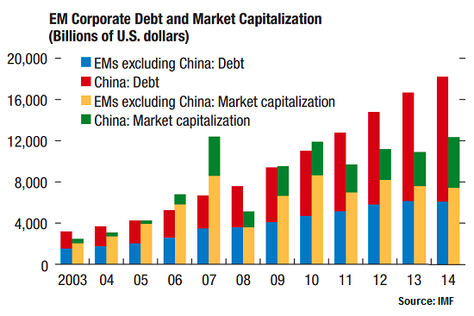
China Dominates GEM Corporate Debt
Wall Street Journal 9/29/2015

Slide 19
10-year Treasury Yield-December 2018
Country | Yield
China | 2.80%
India | 7.10
Russia | 8.23
USA | 2.10
Brazil | 11.99

Slide 20
Moody’s Debt Rating—December 2018
Country | Rating
China | A1
India | Baa2
Russia | Ba1
USA | Aaa
Brazil | Ba2

Slide 21
GEM Performance: Commodities
Prices highly volatile
Depend on demand and supply conditions
Demand depends on global growth and the state of production technologies
Supply depends on economic, political, and technological conditions of different countries (unrest in Libya and Nigeria affect the oil supplies of these countries)

Slide 22
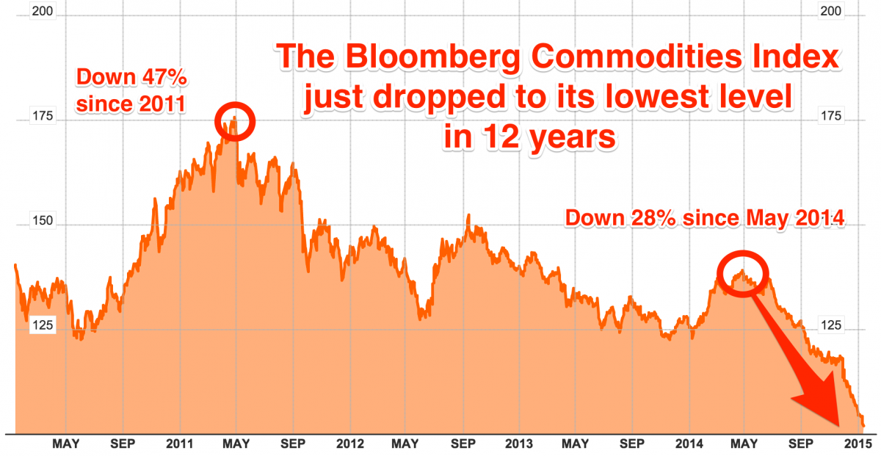
Commodity Prices Are Highly Volatile
Source: Bloomberg, Business Insider 1/14/2015

Slide 23
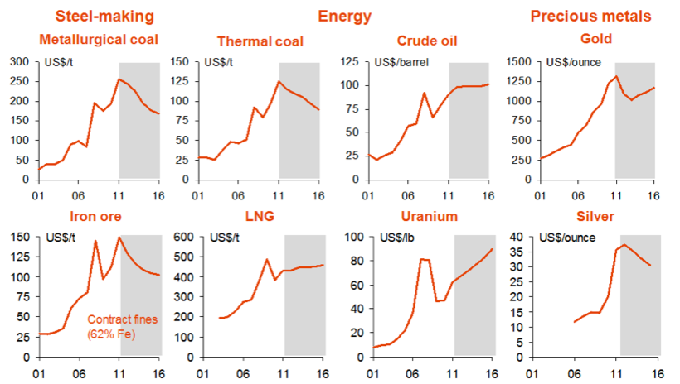
A Sample Of Commodity Prices In 1916
http://econbrowser.com/archives/2015/11/commodity-prices-and-exchange-rates

Slide 24
Emerging versus Mature Economies: Let’s Look at the Numbers
GDP growth
Per Capita GDP
Inflation and Unemployment
Debt to GDP ratios
Trade and capital flow
Wages and international competitiveness

Slide 25
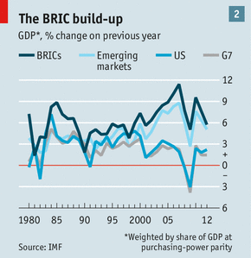
Emerging vs Mature Market Growth
http://www.economist.com/news/briefing/21582257-most-dramatic-and-disruptive-period-emerging-market-growth-world-has-ever-seen

Slide 26
GDP Growth For Selected EME In 2017
Country | GDP Growth yoy
China | 6.80%
India | 6.30
Russia | 1.80
South Africa | 2.00
Brazil | 1.40
Source: Tradingeconomics.com

Slide 27
Historical Growth Rates
For the period 2000-2010, BRICS economies grew by 112%, while the the US, UK, Japan grew by 14%.
In 2000, emerging market countries grew by 6.5%, while developed countries grew by 4%.
In 2010, emerging markets grew by 7.7%, while developed countries by 2.6%.

Slide 28
Per Capita GDP For Selected GEM (2018)
Country | Per Capita GDP
China | $7,329
India | $1,963
Russia | $11,441
South Africa | $7,524
Brazil | $10,883
Source: Tradingeconomics.com

Slide 29
Per Capita GDP For Selected Mature Economies (2018)
Country | Per Capita GDP
US | $53,128
Japan | $48,556
Germany | $46,747
Source: Tradingeconomics.com

Slide 30
Income Inequality A Serious Problem In GEM--India

Slide 31
Inflation Rate A Big Problem For Some GEM

Slide 32
Inflation A Big Problem For Some GEM

Slide 33
Inflation A Big Problem For Some GEM

Slide 34
Inflation Could Be A Big Problem In Some GEM

Slide 35
Debt Could Be A Big Problem
Countries | Debt/GDP
China | 43.90!!!
Brazil | 66.23!
Greece | 176.90
US | 104.17?
Japan | 229.20?
Source: Tradingeconomics.com

Slide 36
Higher Growth Doesn’t Always Translate To Higher Equity Markets
Equity markets usually follow the economy.
A stronger economy usually translates into a stronger market, as it boosts the top and bottom business lines.
But not always, e.g., China, where corporations aren’t profit oriented.
“Heavy handed” intervention plays a role, too.

Slide 37
Emerging Market Institutions and Policies “Economic Regime”
Backwards combination of markets and government
Ranking Low Index of Economic Freedom
Ranking High On the Corruption Index
Ranking Low On Entrepreneurship Index
Ranking Low On International Competitiveness Index
But there are exceptions (e.g., Estonia)

Slide 38
Index Of Economic Freedom Ranking in 2017
Country | Ranking
China | 111/179
India | 143
Russia | 114
South Africa | 81
Brazil | 140
Source: Tradingeconomics.com

Slide 39
Corruption Ranking (2017)
Country | Ranking
China | 77/175
India | 81
Russia | 135
Czech Republic | 37
Brazil | 96
Source: Tradingeconomics.com

Slide 40
Index Of International Competitiveness Ranking (2017)
Country | Ranking
China | 28/140
India | 40
Russia | 38
Czech Republic | 31
Brazil | 80
Source: Tradingeconomics.com

Slide 41
Index Of Global Entrepreneurship Ranking in 2017
Country | Ranking
China | 60/132
India | 98
Russia | 68
South Africa | 46
Brazil | 92
Source: Tradingeconomics.com

